Slide 1
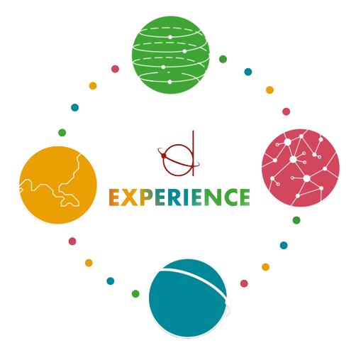

Slide 2
Social Economy: European Perspectives and Recommendations for the Local Actors

Slide 4
How to help social economy grow: some examples
Policy Support at national level
- bylaws and policy measures
- laws on social enterprise/social economy (good and bad examples…) Spain, UK, France… Albania, Serbia, Poland
- national strategies (Ireland, Germany, Uk, Scotland)
Important:
- dedicated budget for the measures / law
- laws and policies instruments = dialogue with stakeholders

Slide 5
How to help social economy grow: some examples that work
the Government assigned policy responsibility for social enterprise to the newly established Department of Rural and Community Development. The strategic objectives of the Department include the advancement of the economic and social development of both rural and urban communities, and enabling communities disadvantaged by location or social issues to reach their full potential. The assignment of responsibility for social enterprise to the Department of Rural and Community Development provides an unprecedented opportunity for policy on social enterprise to be developed in a coordinated and integrated way

Slide 6
How to make social economy grow: some examples that work
Italy - Public Contract Code
One notable aspect is the emphasis on social and occupational inclusion. Specifically, Articles 57 and 61 of the code require tender notices to include specific clauses that guarantee the inclusion and a safer working environment for employees of economic operators and subcontractors. This measure aims to promote social cooperatives and enhance their participation in public contracts

Slide 7
How to support policy makers: some examples that work(ed)
Mutual learning (EC)
Peer – learning and study visits between policy makers and among policy makers and social economy support organisations
Peer reviews for ESF management authorities in Europe (Poland, Flanders, Italy, France, Scotland, Spain…)

Slide 8
Energy and communities
Energy communities play a crucial role in advancing the clean energy transition across Europe. These community-driven initiatives empower citizens to actively participate in reshaping our energy systems. Here are some key points about energy communities:
Definition and Purpose:
Energy communities are collective efforts organized around open, democratic participation and governance.
They aim to provide benefits to their members or the local community by promoting clean energy adoption and efficiency.
Legal Recognition:
The Clean Energy Package, which includes EU legislation, recognizes certain categories of community energy initiatives as “energy communities.”
These communities can take various legal forms, such as associations, cooperatives, partnerships, non-profit organizations, or limited liability companies.

Slide 9
Thank you!

