Slide 1
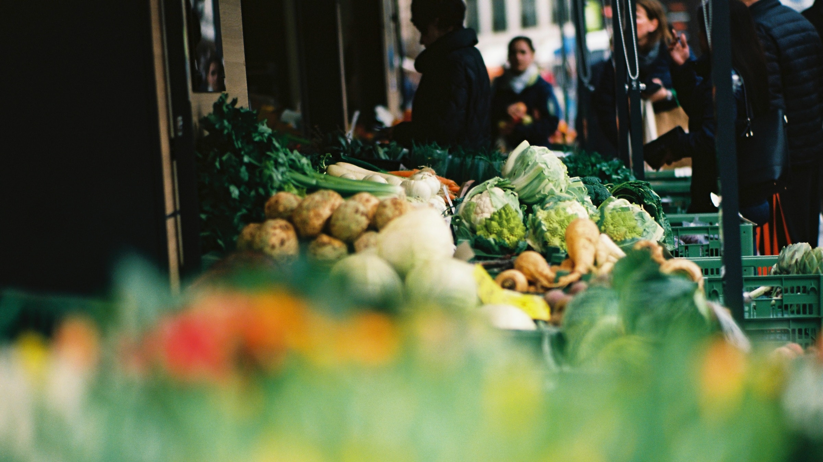

Slide 2
Why GRAINS?
1
Agrifood sector is vital in achieving the European Green Deal
supported by the Common Agricultural Policy (CAP).
Twin Transition has become a transversal priority for the European Union,
Social Economy plays a crucial role in this transition
Build a greener and more equitable agrifood sector, promoting inclusive and sustainable models.
Notes:
Supporting the transition of social economy SMEs towards sustainable and environmentally friendly practices and production processes.
Promoting the adoption of sustainable technologies and innovations in the agri-food
Building the capacity and competitiveness of social economy SMEs through knowledge transfer and skills development in sustainable practices.
Fostering transnational cooperation, best practice sharing, and promoting sustainable practices through awareness-raising efforts.

Slide 3
About the GRAINS project
Duration 24 month
Now in 2nd phase
2
aims to address challenges faced by SMEs in agrifood by providing training on sustainable practices and on how to reduce their environmental footprint.​​
​​
knowledge transfer, and cooperation
Capacity building

Slide 4
Main activities
3
8 European capacity building trainings
Coaching and mentoring advice services to 30 SMEs
Business advisory services to 40 SMEs
Financial support to 60 SMEs
Awareness raising campaigns

Slide 5
Capacity building trainings
4
2nd YEAR PROGRAMME
is LIVE!
DELIVERED BY BEST BEST EXPERTS FROM SOCIAL ECONOMY SECTOR in EUROPE
To....boost the uptake of sustainable practices and enable development of local green markets
FOCUS ON >> Enviromental Footprint and Greening Agrifood Market ​<<
Food Loss and Enviromental Food Footprint , 29th January 2025 (online)
Biodiversity and resilience, March 2025 (online)
Local markets ( In person/hybrid) Rome, June 2025

Slide 6
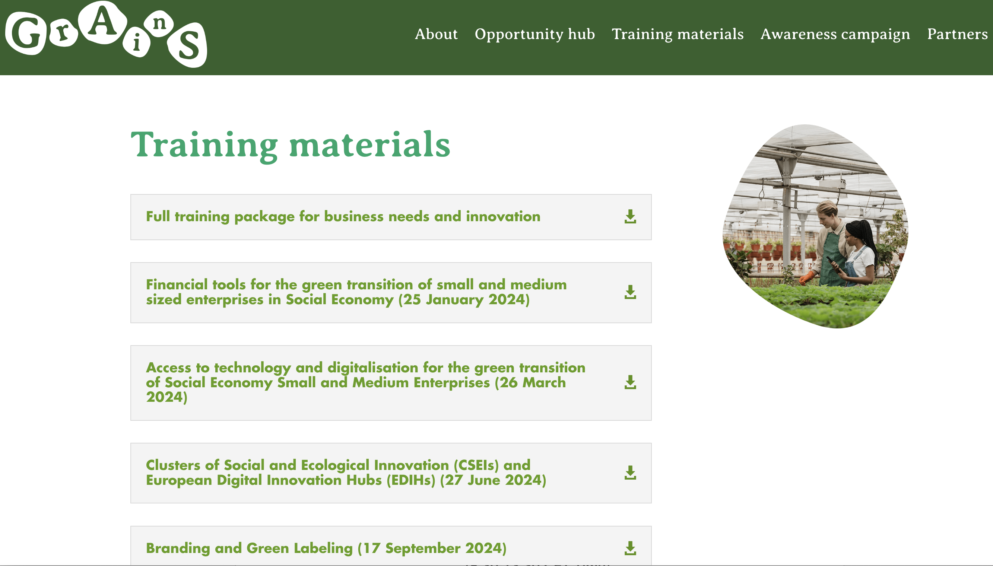
Capacity building trainings
5
TRAINING MATERIAL
AVAILABLE!

Slide 7
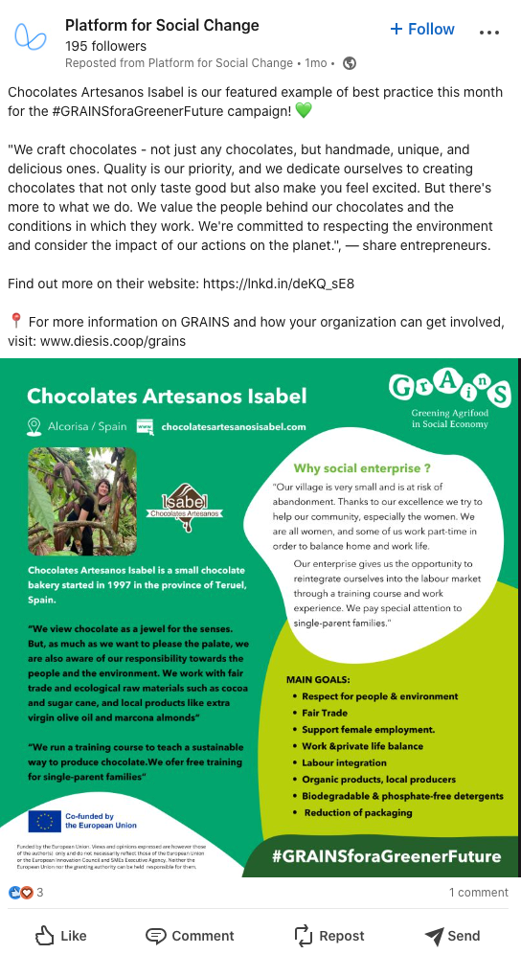
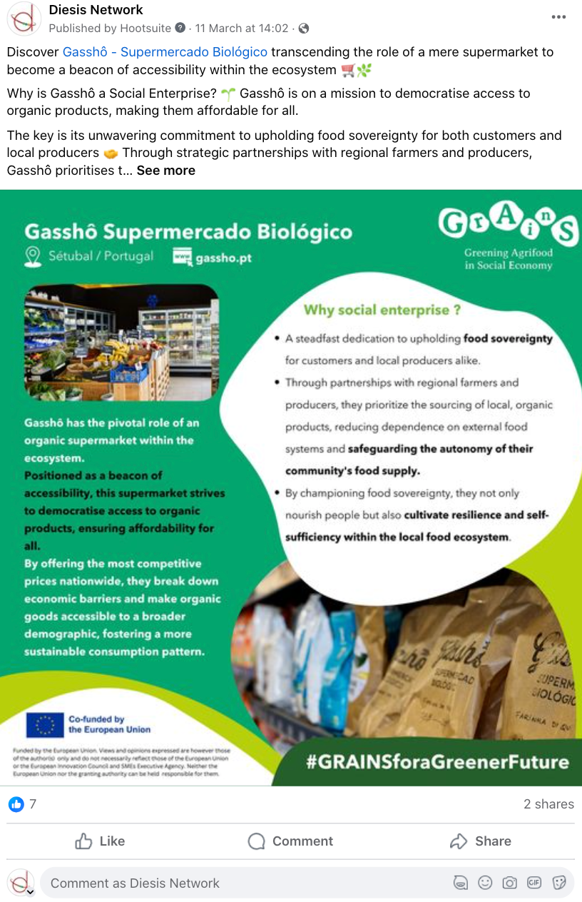
What can you find?
BEST PRACTICES
Dissemination of inspiring examples at EU level
EDUCATIONAL CONTENT
Learning resources for all
COLLABORATIONS
Other key platforms such as EU Cap Network, Future Food Institute, Rural Pact Platform…

Slide 8
Get involved!
Share your best practices via
grainsproject@diesis.coop
Join the conversation
#GRAINSforaGreenerFuture

Slide 9
Partners:

Slide 10
Thank you !
For more information
grainsproject@diesis.coop
https://www.diesis.coop/grains/

